Slide 1
Presentation to the Annual AES Conference, Sydney, 2011
Paper # 352, Room 3 Level 4,
Hilton Sydney Hotel, Friday 2 September 2011
Mr. Stanley Raka
Development Coordinator,
SNS SP (Coffey International)

Slide 2
Presentation Outline
Introduce PNG Law and Justice Sector
Harvard Indicators Project-International Perspective
Project Purpose & Objective
Law and Justice Sector Indicators Project
4 Prototype Indicators for PNG LJS
Presentation Focus-Village Courts Indicator
Village Courts-Background
Evaluation & Influence-The village Courts Indicator development experience
Influence & Yielded results of VC Imprisonment Order Indicator
Case Study-NCD 2009
Progress to Date
Acknowledgements

Slide 3
Introducing the PNG Law and Justice Sector
The Papua New Guinea Law and Justice Sector is a Sectoral Coordination Mechanism established for the eight (8) independent constitutional law and justice agencies.
These eight agencies include;
National Judicial Staff Services (NJSS)
Magisterial Services (MS)
PNG Ombudsman Commission
Royal PNG Constabulary (RPNGC-Police)
Correctional Services (CS)
Department of Justice & Attorney General
Office of Public Prosecutor
Office of Public Solicitors

Slide 4
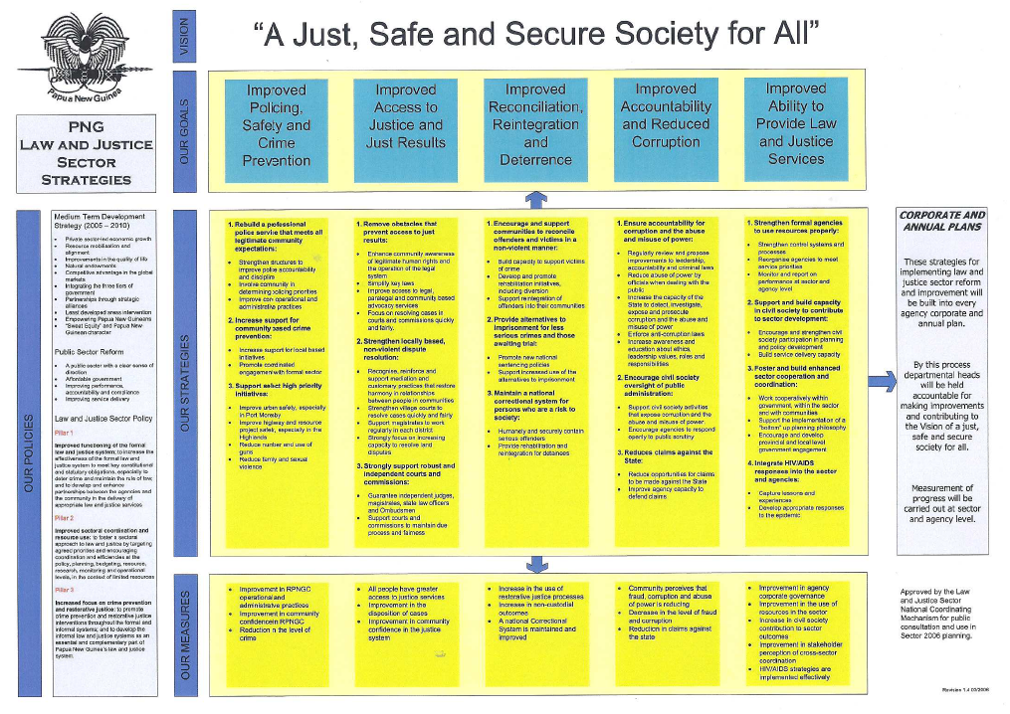

Slide 5
Harvard Indicators Project (HIP) International Perspective
Currently, working with five countries to use existing data for safety and justice indicators purposes: Bangladesh (2010) - the most recent country to join the group; Papua New Guinea (2009) Sierra Leone; Jamaica; and Nigeria (Since 2008)
Work in Sierra Leone, Jamaica, Nigeria and Bangladesh is funded by DFID, the United Kingdom's Department for International Development.
AusAID funds the support to the Harvard Indicators Project in Papua New Guinea

Slide 6
Project Purpose & Objective
Project's purpose: strengthen the capacity of governments in developing countries and their partners in civil society to measure progress in safety and justice.
Project objective: For the governments of partner countries to design and use its own set of empirical indicators to steer and document changes in safety and justice.
This project is utilizing existing data generated by government departments and serving existing management structures within the justice and safety sector of participating countries.

Slide 7
Law and Justice Sector Indicators Project- Partnership with the Harvard Program in Criminal Justice
The PNG Law and Justice Sector (NCM) granted approval for the Indicators Project in September 2009.
In November 2009, PNG Law and Justice Sector representatives attended the 2nd Annual Harvard Indicators Workshop at Harvard University in Boston, Massachusetts.
After an August 2010 in-country visit by the Harvard research team, the working group and the Harvard team decided to focus on four prototype indicators for the PNG Law and Justice Sector.
The Harvard research team has visited PNG five times since the partnership developed in 2009.

Slide 8
Four Prototype Indicators / focus areas proposed for PNG L&J Sector
1) Measuring change over time in village court use of imprisonment orders, and how district courts and police respond to the use of these orders.
Measuring the change over time in the growth rate of private security personnel in PNG.
Measuring the change over time in the flow of firearms in the country, perhaps by using police data to track firearms used in crimes.
An indicator that might measure public confidence and the integrity of justice sector agencies and assist the Ombudsman Commission with service delivery.

Slide 9
Presentation Focus-Village Courts Imprisonment Orders
This presentation will look at the work that has been done, and the use made of this work, with the village courts.
The project has tracked the number of warrants for arrest and warrants of commitment issued by District Courts in response to these village court requests,
The Harvard research team so far have covered 3 provinces
Nations Capital-Port Moresby,
Wewak in East Sepik Province and
Goroka in the Eastern Highlands Province.

Slide 10
Village Courts-Background
The village Courts is a Traditional Legal System in PNG
Over 1440 village courts across PNG – existed formally since 1975 – recognised in the PNG Constitution and created by law
95% coverage of PNG communities (including urban settlements and remote villages ) and exists in every province
Over 14,000 officials – between 8-12 in every court
The biggest system of justice in PNG – each year they deal with over 250,000 to 300,000 cases (500,000 to 600,000 people per year to whom the Village Court services are delivered)

Slide 11
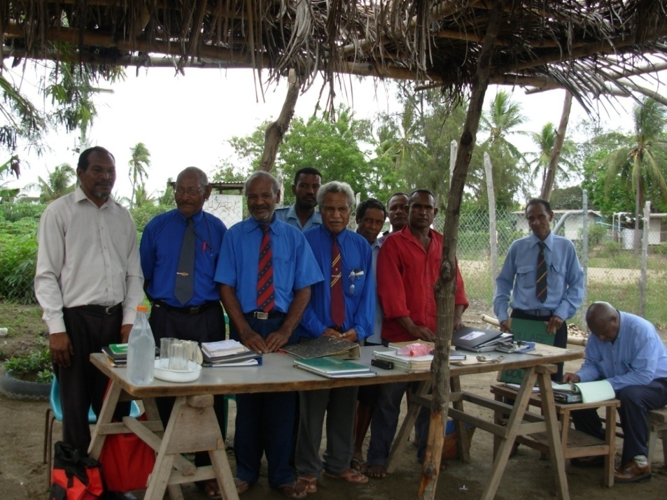
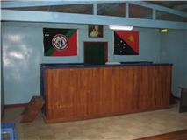
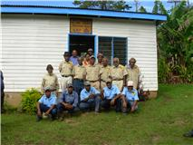
Administering Village Court Services in PNG

Slide 12
Evaluation & Influence-The Village Courts Indicator development experience
The most progress on developing an indicator for PNG has occurred with the Village Court Imprisonment Order indicator.
Multiple justice sector actors have worked together, in Port Moresby and across PNG, to collect and analyze data on village court use of, and district court and police response to, village court imprisonment orders.
The cross-sector partnership for the development of this indicator includes the Village Court and Land Mediation Secretariat; Magisterial Services; Provincial and District Village Court Officers; and Village Court magistrates and officials.

Slide 13
Influence & yielded results of Village Courts-Imprisonment Order Indicator
New and strengthened relationships between MS and the Village Court Secretariat;
New and strengthened relationships between the police and village court officers, for example between police in NCDC and the NCDC provincial village court officer;
Planned updates to village court quarterly return forms;
The discovery that different versions of the Village Court Act were being used throughout district courts and efforts to ensure that the correct version of the Act is being followed;
Efforts by specific sub-national governments to investigate the use of imprisonment orders by village courts, for example the ARB government’s planned audit of all village courts on the island, to begin in July 2011.

Slide 14
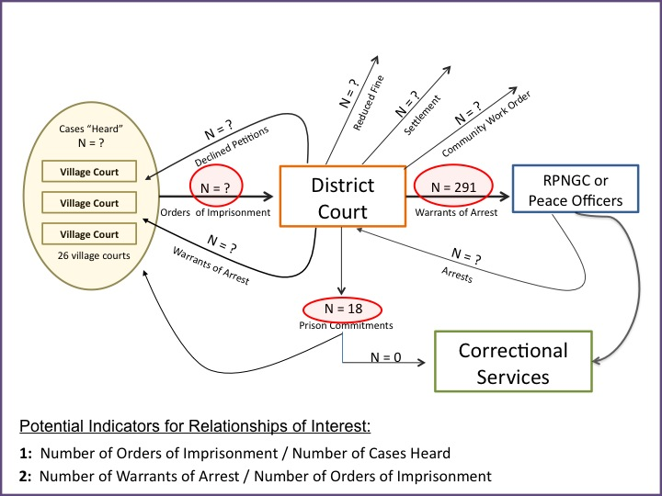
Case Study: Review of Village Court Orders of Imprisonment - NCD National Capital District, 2009

Slide 15
Imprisonment Order Data National Capital District, 2009
# of Imprisonment Orders issued by Village Courts = 1267 (estimate), 22% of all cases heard
# of Imprisonment Orders received by District Court = ??
291 Warrants of Arrest issued by District Court, 23% of IOs
18 Warrants of Commitment issued
2 Warrants of Commitment sent to police for execution
0
Persons recorded imprisoned by Correctional Services
How are village courts using IOs?
How are other agencies responding?

Slide 16
Progress to Date
The Harvard team has analyzed and presented the data, and will continue to assist the cross-sectoral team in developing a measurement to track changes such as number of warrants of arrest issued vs. number of imprisonment orders received by District Courts.
Since July the analysis of data from the three different areas of PNG, by the Harvard team will be able to help the interested agencies—the Village Court Secretariat, MS, police, and provincial authorities—to develop an indicator for these agencies to use together for 2011.

Slide 17
Acknowledgements
The PNG Law and Justice Sector acknowledges AusAID for its funding support to this project. It is a highly valued program and project support for the PNG law and Justice Sector
Harvard Kennedy School of Governance is also acknowledged for their dedicated support to this project
AusAID SNS and Coffey International for bringing me here to share this milestone achievement not only for the PNG Law and Justice Sector but for Monitoring & Evaluation in Papua New Guinea as a whole.
Kate Averill and Evaluation Consult for sponsoring my attendance to the 2009 AES Conference in Canberra-Catalyst for my emergence in M&E profession
Jenny Rush for her continuous mentoring and supportive role to our PNG Association of Professional Evaluators Inc.

Slide 18
Em tasol Tenkyu tumas Questions???

